Slide 1

The Enterprise Clown
Builds SharePoint apps
with Node.js
@bjartnes and @TheEnterpriseClown
Notes:
(This is my first public appearance as a clown. By the looks I get I’m starting to wonder if it’ll be my last.)
I am Bjørn Einar Bjartnes, a developer in Computas (I hope it doesn’t ruin the story, but honestly I am quite happy there). Today I am here to tell you the story of my alter ego, The Enterprise Clown:
At some point Bjørn took the red pill and he saw what was outside the Enterprise Software world. He saw what the cool kids were doing on GitHub and saw with his own eyes how lean software they made. He learned that the true battle is between VIM and Emacs, not Visual Studio and Ecllipse. He learned about simple vs easy. He discovered the history of our industry, of which little is spoken in the Enterprise.
His eyes seeing clearer every day, the way of the Enterprise makes Bjørn sad. To stay sane he sometimes lets his Enterprise Clown out. The clown does stuff that does not not traditionally belong in the corporate world, cunningly disguised as a harmless clown. Sometimes he even manages to put a smile on Bjørn’s face. The clown helps him stay sane while he dreams of better days for our industry.

Slide 2
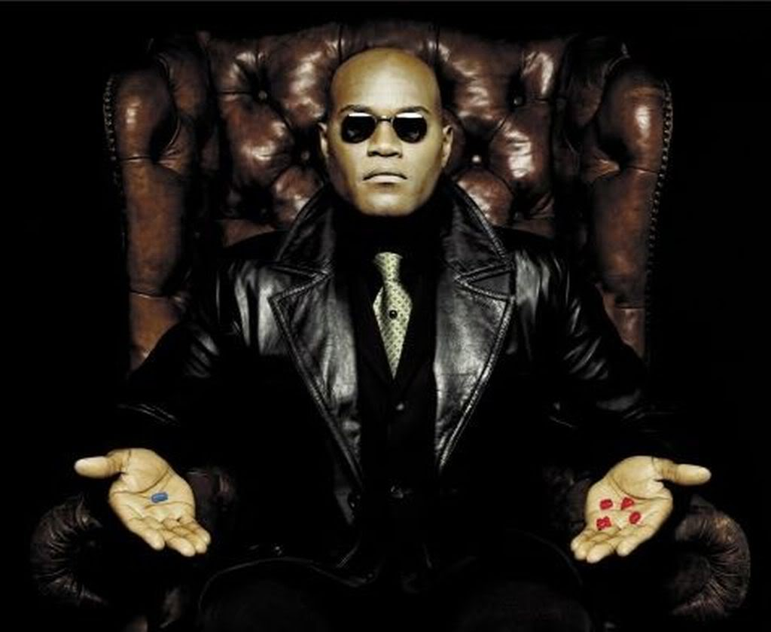
Notes:
The blue pill represent Enterprise Software of today. The red opens your eyes to what is out there.
Come on, let’s together take the red AND the blue pill. The purple trip might expand our consciousness and bring us closer to the true path of what Enterprise Software could be like.

Slide 3
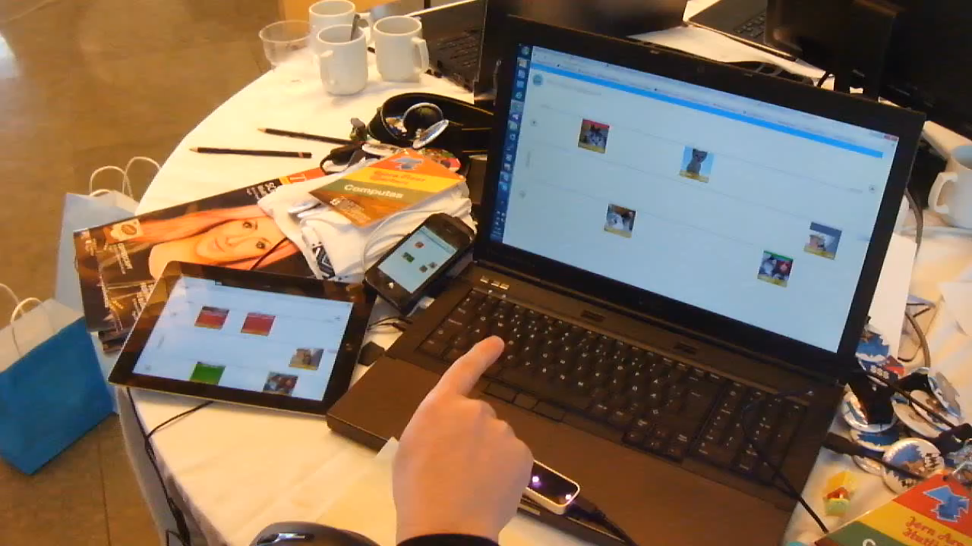
Notes:
The clown was let loose with some friends at The Arctic SharePoint Challenge. I’ll just show you the result first to avoid being too abstract.
Multi-user, real-time app. What you see here is a SharePoint App, it’s a task list, but it’s running in node.js. It’s running on Nodejitsu, a learn node.js cloud provider.
Leap-motion, real time over atlantic on mobile devices.

Slide 4
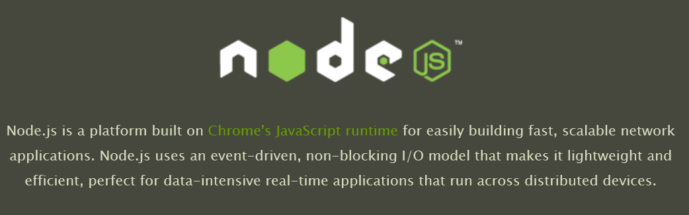
Notes:
Works on Windows, Linux and Mac.
Professional support
Microsoft using and support node
More than JavaScript on the server
- Distributed network applications
Lean
Functionality in modules
NPM
You choose dev. env.
Hipster factor: Almost Erlang and Clojure

Slide 5
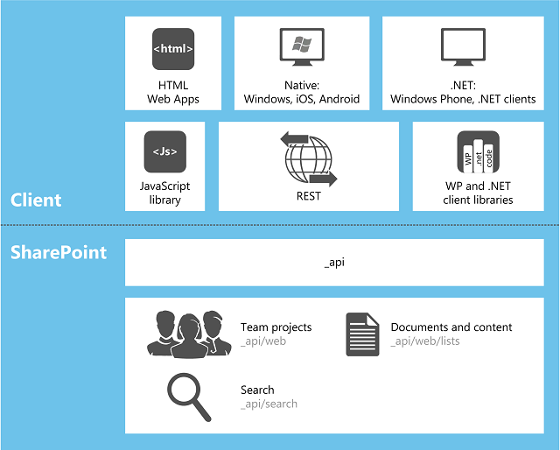
Notes:
Enterprisy monolithic product
IDE Driven Development assisted by wizards
Hipster factor: near zero
2013 really opened up with embracing the web.

Slide 6

Notes:
Good Wizard

Slide 7
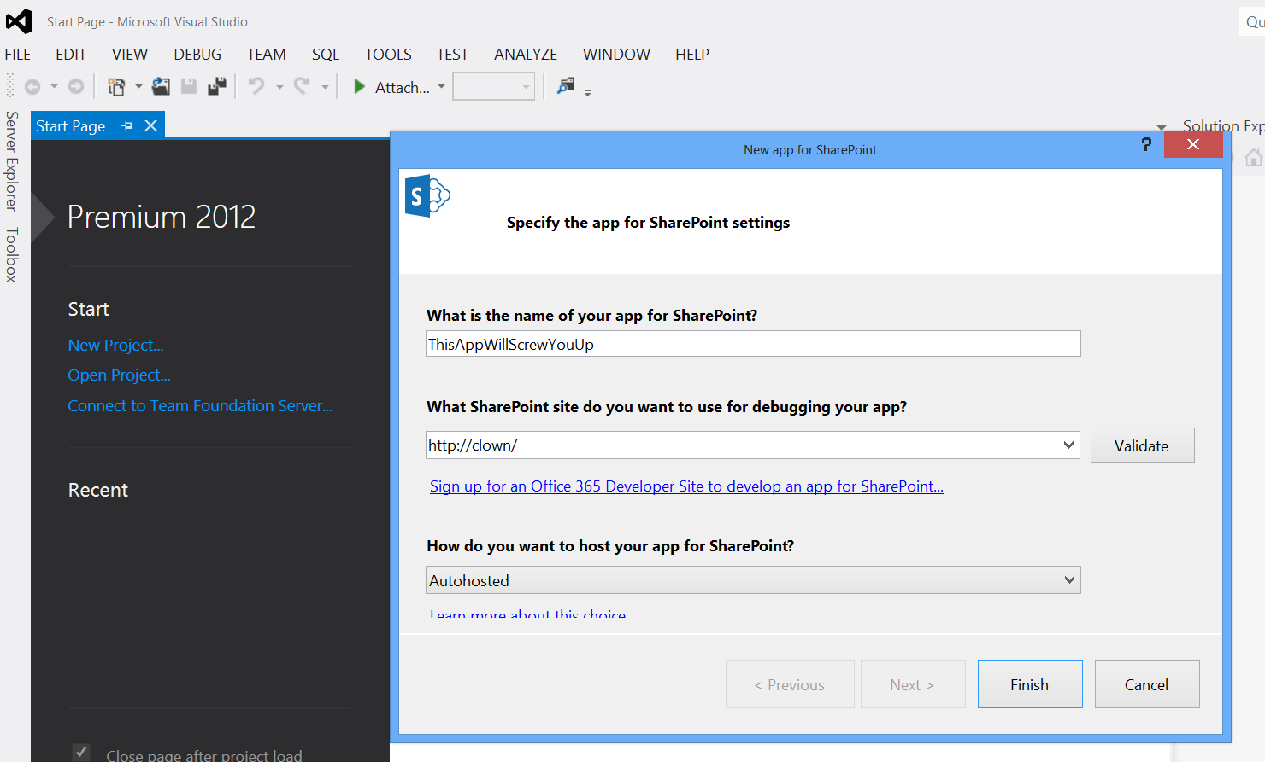
Notes:
Evil wizard
Blurring your eyes
You can no see or undertand what happens
Either someone solved the DevOps-thing witha dropdown OR this is a major leaky abstraction

Slide 8
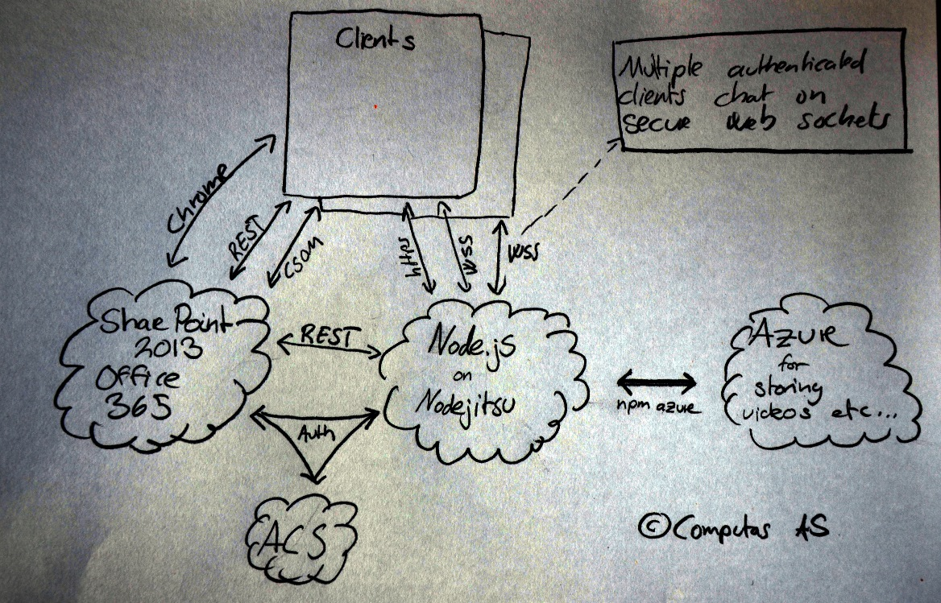
Notes:
THIS is what I mean with distributed network application. At least three servers, possibly more, and multiple clients. On the Internet. This is not the old server-client model.

Slide 9
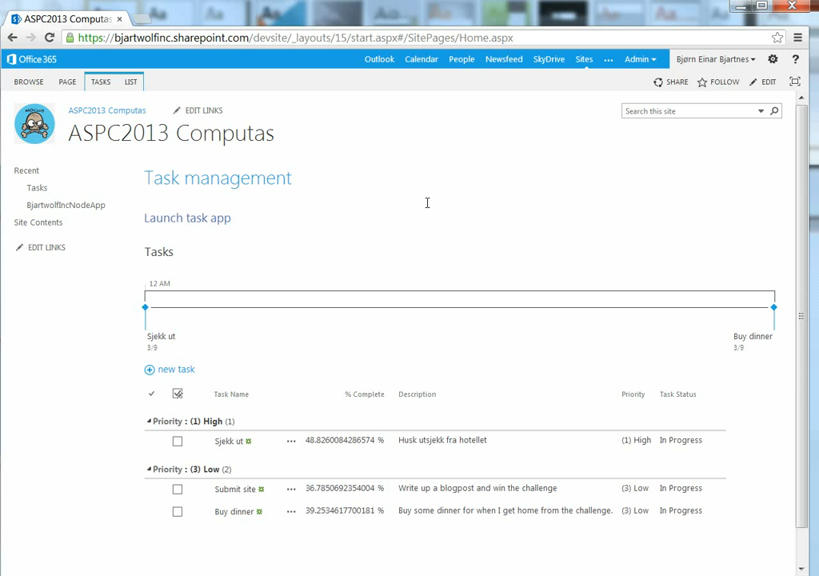

Slide 10
The results
Lightweight
Cheap to host and scale
Possible to understand
Leverage modules
npm
*nix processes

Slide 11
Macrauder at github.com/queport for the passport strategy
@askildt, @jornare, @ellafy for helping me building the app
https://github.com/bjartwolf/SP2013Node
Notes:
And it’s worth mentioning that this is hackathon code written by a clown and his friends. While the ideas are sound, the code might not be.

Slide 12
«Dare to wear the foolish clown face»
Frank Sinatra

